Slide 1
Lecture 21
Graph (III)

Slide 2
Outline
Minimum Spanning Trees
  Prim’s Algorithm
  Kruskal’s Algorithm

Slide 3
Minimum Spanning Trees
A tree that is build up out of all the vertices and some of the edges of G is called a spanning tree of G.
  Undirected
  Connected
  Acyclic
A minimum spanning tree (MST) of a connected network is a spanning tree such that the sum of the weights of its edges is as small as possible.
A connected,
undirected graph
Four of the spanning trees of the graph

Slide 4
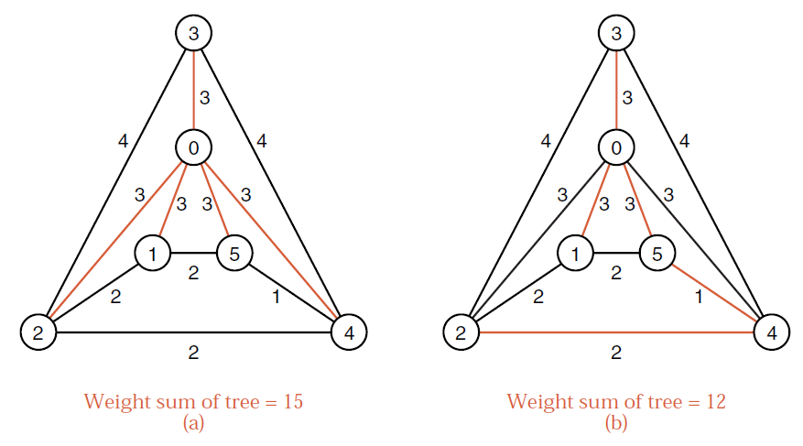
Two Spanning Trees

Slide 5
Prim's Algorithm for Minimum Spanning Trees
Prim's algorithm for finding an MST is a greedy algorithm.
Start by selecting an arbitrary vertex, include it into the current MST.
Grow the current MST by inserting into it the vertex closest to one of the vertices already in the current MST.
Repeat until all vertices are in the tree.

Slide 6
Example of Prim’s Algorithm
Not in tree
a/0
5
b/∞
7
c/∞
1
-3
Q = a b c d e f
0 ∞ ∞
11
3
d/∞
0
e/∞
2
f/∞

Slide 7
Example of Prim’s Algorithm
a/0
5
b/5
7
c/∞
1
-3
Q = b d c e f
5 11 ∞ ∞
11
3
d/11
0
e/∞
2
f/∞

Slide 8
Example of Prim’s Algorithm
a/0
5
b/5
7
c/7
1
-3
Q = e c d f
3 7 11 ∞
11
3
d/11
0
e/3
2
f/∞

Slide 9
Example of Prim’s Algorithm
a/0
5
b/5
7
c/1
1
-3
Q = d c f
0 1 2
11
3
d/0
0
e/3
2
f/2

Slide 10
Example of Prim’s Algorithm
a/0
5
b/5
7
c/1
1
-3
Q = c f
1 2
11
3
d/0
0
e/3
2
f/2

Slide 11
Example of Prim’s Algorithm
a/0
5
b/5
7
c/1
1
-3
Q = f
-3
11
3
d/0
0
e/3
2
f/-3

Slide 12
Example of Prim’s Algorithm
a/0
5
b/5
7
c/1
1
-3
Q = ∅
11
3
d/0
0
e/3
2
f/-3

Slide 13
Example of Prim’s Algorithm
a/0
5
b/5
c/1
3
1
-3
d/0
0
e/3
f/-3

Slide 14
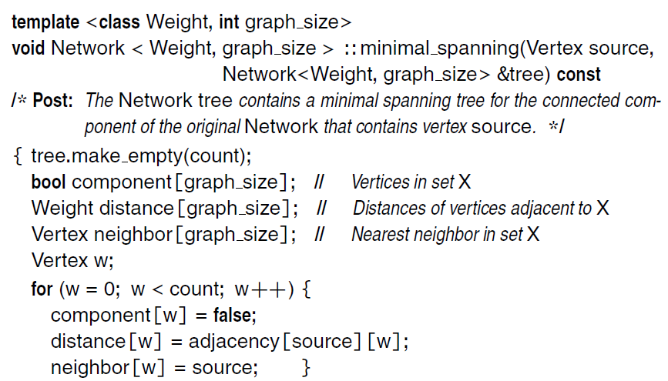
Implementation of Prim's Algorithm
If there is no edge between (u,v),
then adjacency[u][v]=+∞

Slide 15
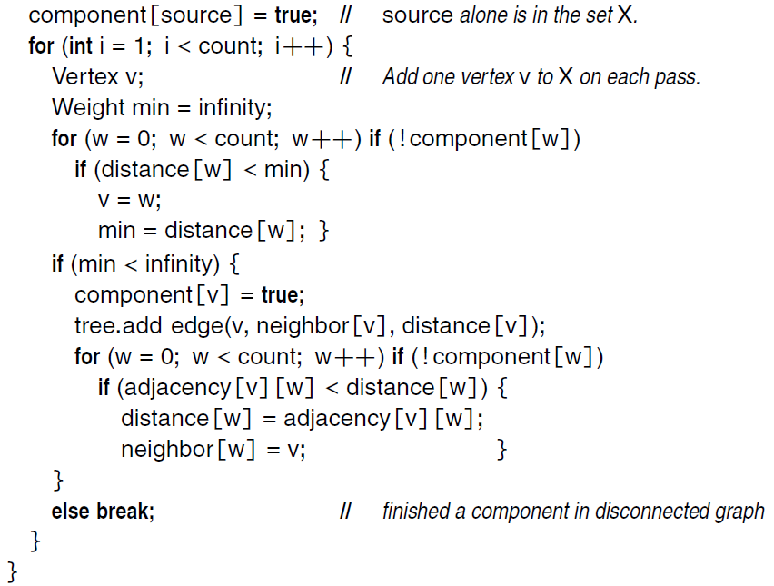
Find the vertex in Q
closest to the current MST
Update the distance

Slide 16
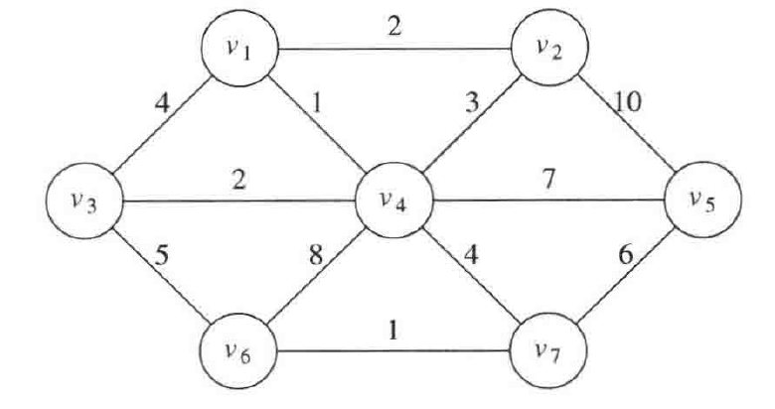
Exercise
Use Prim’s algorithm to construct a minimum spanning tree of the following graph, rooted at v₅.

Slide 17
Time Complexity
A Generic MST Algorithm:
Q := V[G];
for each u ∈ Q do
dis[u] := ∞
od;
dis[r] := 0;
π[r] := NIL;
while Q ≠ ∅ do
u := Extract - Min(Q);
for each v ∈ Adj[u] do
if v ∈ Q and w(u, v) < dis[v]
then π[v] := u;
dis[v] := w(u, v)
fi
od
od
Complexity:
Naive implementation:
O(V²)
Using binary heaps:
O((V+E) lg V).
Using Fibonacci heaps:
O(E + V lg V).

Slide 18
Kruskal's Algorithm for Minimum Spanning Trees
Kruskal's Algorithm is directly based on the generic MST algorithm. It builds the MST in forest.
Initially, each vertex is in its own tree in forest. Then, the algorithm considers each edge in turn, order by increasing weight.
If an edge (u, v) connects two different trees, then (u, v) is added to the set of edges of the MST, and two trees connected by an edge (u, v) are merged into a single tree.
On the other hand, if an edge (u, v) connects two vertices in the same tree, then edge (u, v) is discarded.

Slide 19
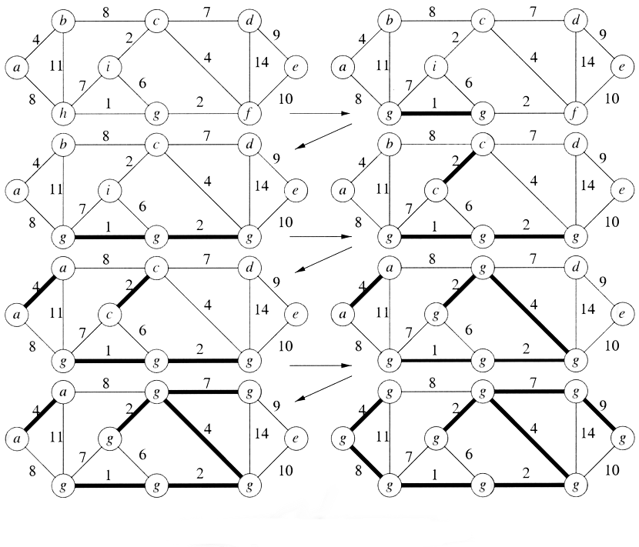
Kruskal's Algorithm for Minimum Spanning Trees

Slide 20
Kruskal's Algorithm
1 A ← ∅ // initially A is empty
2 for each vertex v ∈ V[G] // line 2-3 takes O(V) time
3 do Make-Set(v) // create set for each vertex
4 sort the edges of E into non-decreasing order by weight w
5 for each edge (u,v) ∈ E, taken in non-decreasing order by weight do
6 if Find-Set(u) ≠ Find-Set(v) // u&v on different trees
7 then A ← A ∪ {(u,v)}
8 Union(u,v)
9 return A
Make_Set(v): Create a new set whose only member is pointed to by v. Note that for this operation v must already be in a set.
Find_Set(v): Returns a pointer to the set containing v.
Union(u, v): Unites the dynamic sets that contain u and v into a new set that is union of these two sets.

Slide 21
Implementation of Kruskal's Algorithm
int p[maxn],r[maxm];
int cmp(int i, int j) {return w[i]<w[j]};
int find(int x)
{return (p[x] == -1) ? x : p[x]=find(p[x]);}
int union(int x, int y) { p[y] = x;}
int Kruskal() {
int ans = 0;
for(int i=0;i<n;i++) p[i] = -1;
for(int i=0;i<m;i++) r[i] = i;
sort(r,r+m,cmp);
for(int i=0;i<m;i++) {
int e = r[i], x = find(u[e]), y = find(v[e]);
if (x!=y) {ans += w[e]; union(x,y);}
}
return ans;
}

Slide 22
Time Complexity
MAKE-SETs requires O(V)
Edge sorting requires O(E logE)
FIND-SETs and UNIONs perform O(E) time. Assuming the implementation of disjoint-set data structure that uses union by rank and path compression, so amortized in O(E α(V)). (α为反ackerman函数)
α(V) = O(log V) = O(log E)
Total Time: O(E logE) = O(E logV)
If edges are already sorted, O(E α(V)), which is almost linear.

Slide 23
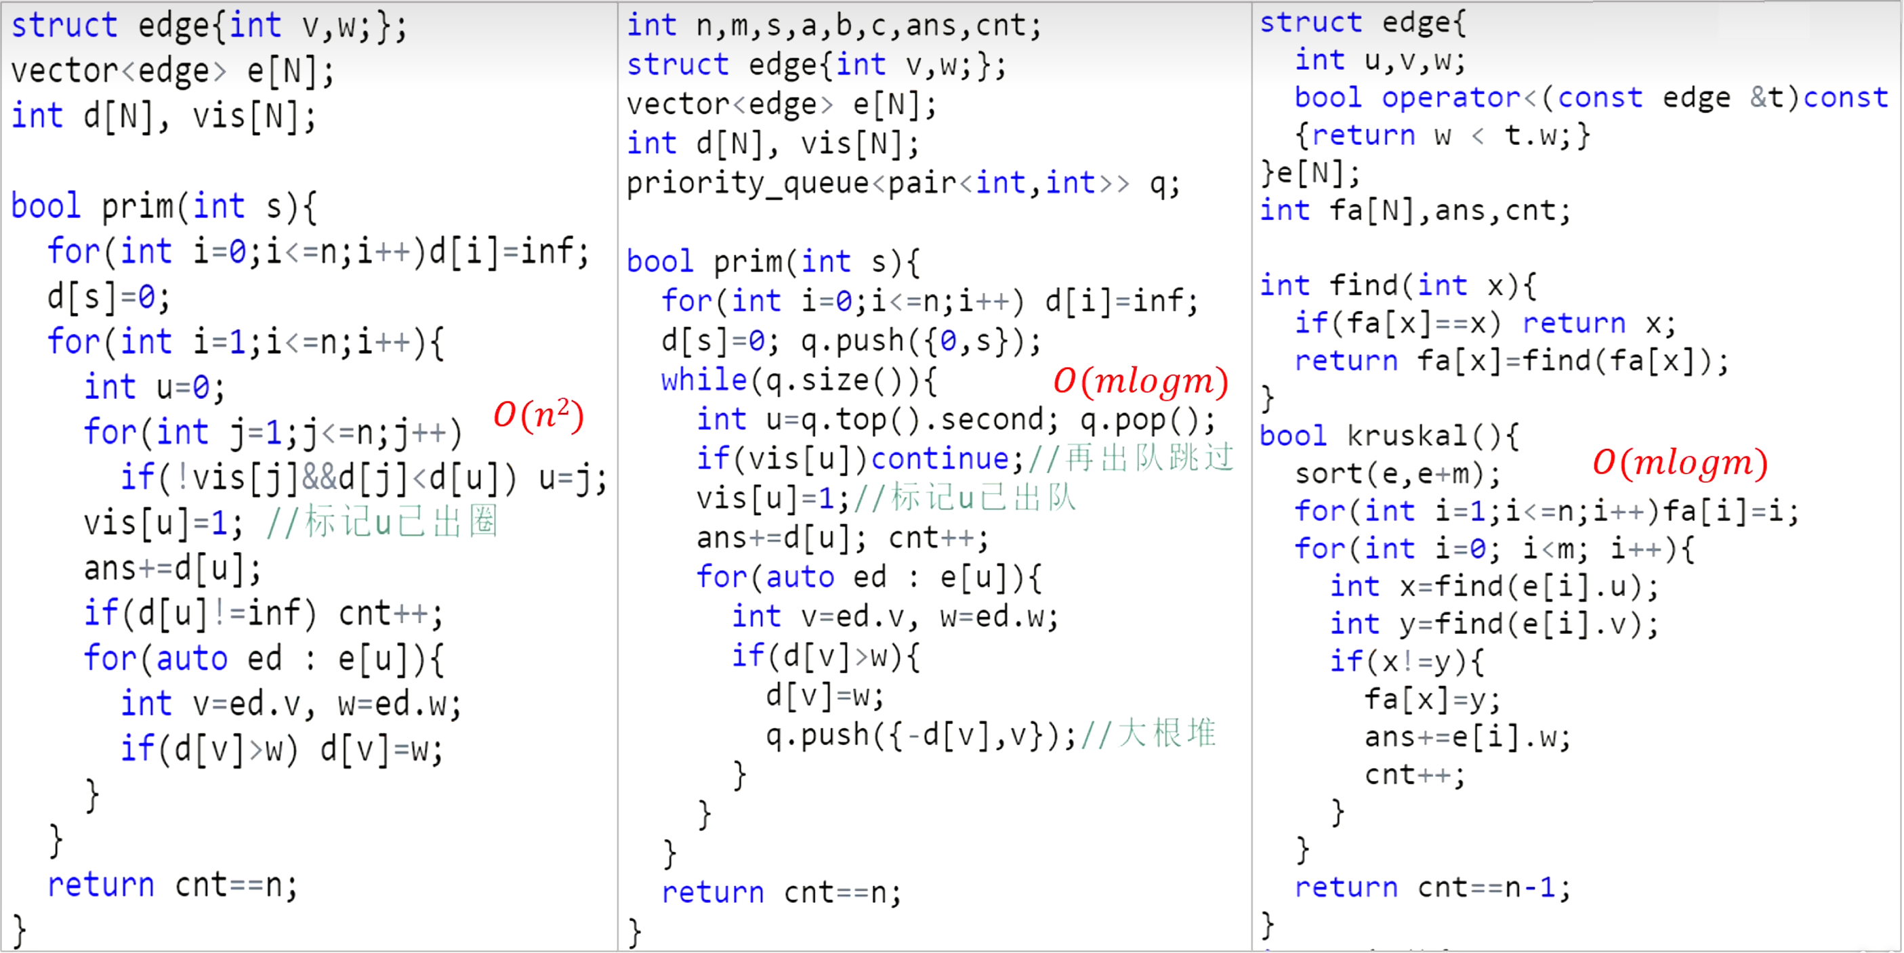
Templates
Lazy implementation of Prim

Slide 24
References
https://www.bilibili.com/video/BV1f54y1d7ba/
  Extended learning: Try to understand lazy implementation and eager implementation of Prim’s algorithm
https://www.bilibili.com/video/BV1gY4y1B7vd/

Slide 25

Thank you!

